Slide 1
What is RAD?
The RAD (Rapid Application Development) model is based on prototyping and iterative development with no specific planning involved. The process of writing the software itself involves the planning required for developing the product.
Rapid Application Development focuses on gathering customer requirements through workshops or focus groups, early testing of the prototypes by the customer using iterative concept, reuse of the existing prototypes (components), continuous integration and rapid delivery.

Slide 2
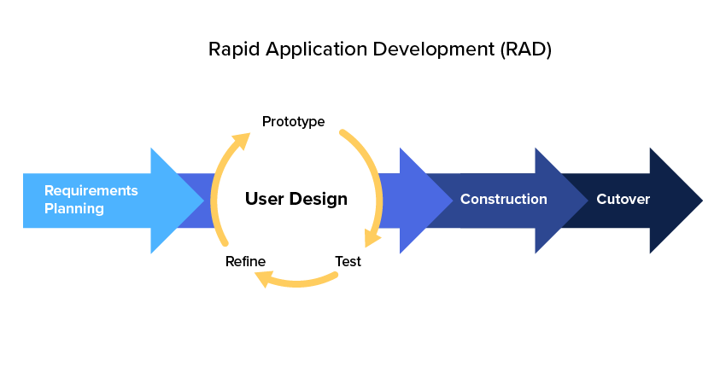

Slide 3
RAD Concepts
RAD (Rapid Application Development) is a concept that products can be developed faster and of higher quality through:
Gathering requirements using workshops or focus groups
Prototyping and early, reiterative user testing of designs
The re-use of software components
A rigidly paced schedule that refers design improvements to the next product version.
Less formality in reviews and other team communication

Slide 4
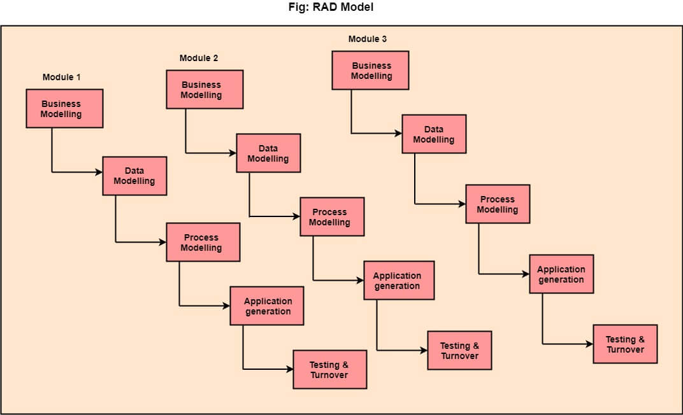
RAD

Slide 5
The various phases of RAD are as follows:
Business Modelling: The information flow among business functions is defined by answering questions like what data drives the business process, what data is generated, who generates it, where does the information go, who process it and so on.
Data Modelling: The data collected from business modelling is refined into a set of data objects (entities) that are needed to support the business. The attributes (character of each entity) are identified, and the relation between these data objects (entities) is defined.
Process Modelling: The information object defined in the data modelling phase are transformed to achieve the data flow necessary to implement a business function. Processing descriptions are created for adding, modifying, deleting, or retrieving a data object.
Application Generation: Automated tools are used to facilitate construction of the software.
Testing & Turnover: Many of the programming components have already been tested since RAD emphasis reuse. This reduces the overall testing time. But the new part must be tested, and all interfaces must be fully exercised.

Slide 6
When to use RAD Model?
When the system should need to create the project that modularizes in a short span time (2-3 months).
When the requirements are well-known.
When the technical risk is limited.
When there's a necessity to make a system, which modularized in 2-3 months of period.
It should be used only if the budget allows the use of automatic code generating tools.

Slide 7
Advantage of RAD Model
This model is flexible for change.
In this model, changes are adoptable.
Each phase in RAD brings highest priority functionality to the customer.
It reduced development time.
It increases the reusability of features.

Slide 8
Disadvantage of RAD Model
It required highly skilled designers.
All application is not compatible with RAD.
For smaller projects, we cannot use the RAD model.
On the high technical risk, it's not suitable.
Required user involvement.

Slide 9
Agile Model
The meaning of Agile is swift or versatile.
"Agile process model" refers to a software development approach based on iterative development.
Agile methods break tasks into smaller iterations, or parts do not directly involve long term planning.
The project scope and requirements are laid down at the beginning of the development process.
Plans regarding the number of iterations, the duration and the scope of each iteration are clearly defined in advance.

Slide 10
Cont..
Each iteration is considered as a short time "frame" in the Agile process model, which typically lasts from one to four weeks.
The division of the entire project into smaller parts helps to minimize the project risk and to reduce the overall project delivery time requirements.
Each iteration involves a team working through a full software development life cycle including planning, requirements analysis, design, coding, and testing before a working product is demonstrated to the client.

Slide 11
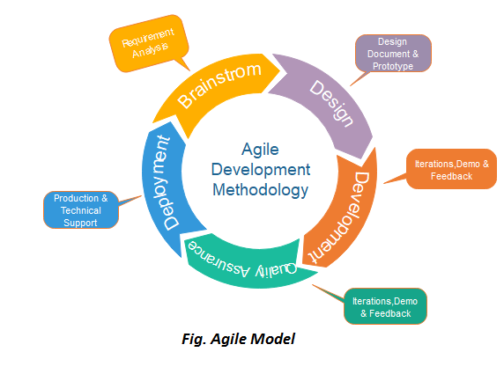

Slide 12
Phases of Agile Model:
Following are the phases in the Agile model are as follows:
Requirements gathering
Design the requirements
Construction/ iteration
Testing/ Quality assurance
Deployment
Feedback

Slide 13
Requirements gathering
In this phase, you must define the requirements.
You should explain business opportunities and plan the time and effort needed to build the project.
Based on this information, you can evaluate technical and economic feasibility.

Slide 14
Design the requirements
When you have identified the project, work with stakeholders to define requirements.
You can use the user flow diagram or the high-level UML diagram to show the work of new features and show how it will apply to your existing system.

Slide 15
Construction/ iteration
When the team defines the requirements, the work begins.
Designers and developers start working on their project, which aims to deploy a working product.
The product will undergo various stages of improvement, so it includes simple, minimal functionality.

Slide 16
Cont..
Testing: In this phase, the Quality Assurance team examines the product's performance and looks for the bug.
Deployment: In this phase, the team issues a product for the user's work environment.
Feedback: After releasing the product, the last step is feedback. In this, the team receives feedback about the product and works through the feedback.

Slide 17
Agile Testing Methods:
Scrum
Crystal
Dynamic Software Development Method(DSDM)
Feature Driven Development(FDD)
Lean Software Development
eXtreme Programming(XP)

Slide 18
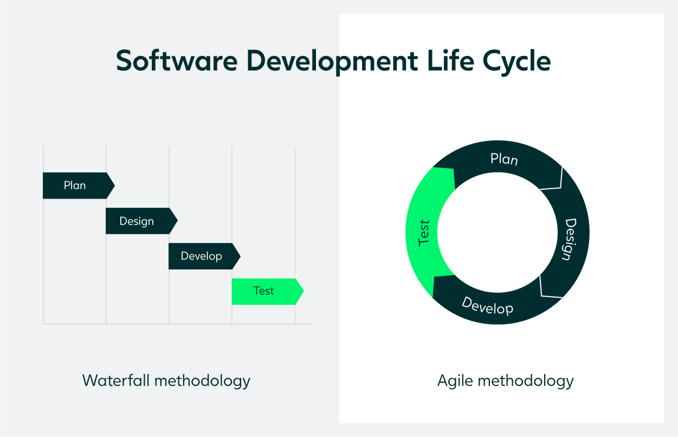
What is agile testing?

Slide 19
Cont..
With the traditional waterfall approach, the testing phase is a standalone process usually executed at the end of the Software Development Life Cycle (SDLC). This comes with the risk of having to make corrections last minute – or not having time to make them at all.
The agile methodology is an attempt to make this qa process more flexible and effective. With this approach, the tester is suddenly at the core of the SDLC, continuously executing tests and getting feedback from customers, developers, and other stakeholders.
With the testing stage occurring alongside development – so-called continuous integration –, it’s possible to debug earlier and improve the quality of the deployed product.

Slide 20
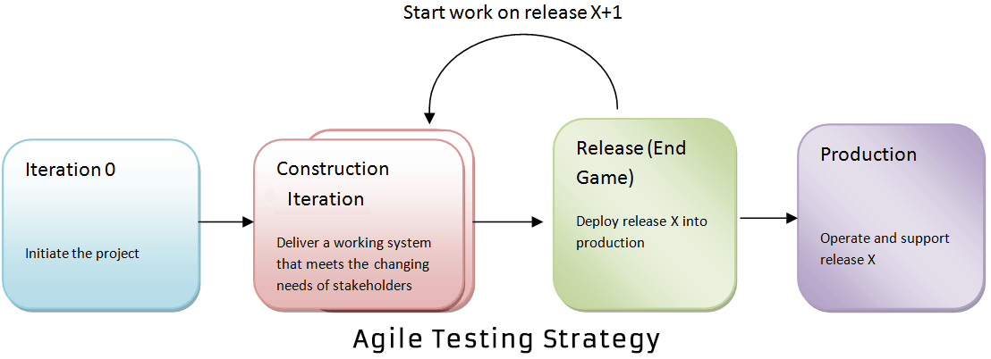
Agile Testing Strategies

Slide 21
Iteration 0
During the first stage or iteration 0, you perform initial setup tasks. It includes identifying people for testing, installing testing tools, scheduling resources (usability testing lab), etc. The following steps are set to achieve in Iteration 0.
Establishing a business case for the project
Establish the boundary conditions and the project scope
Outline the key requirements and use cases that will drive the design trade-offs
Outline one or more candidate architectures
Identifying the risk
Cost estimation and prepare a preliminary project

Slide 22
Construction Iterations
The second phase of agile testing methodology is Construction Iterations, the majority of the testing occurs during this phase.
This phase is observed as a set of iterations to build an increment of the solution.
In order to do that, within each iteration, the team implements a hybrid of practices from XP, Scrum, Agile modelling, and agile data and so on.

Slide 23
Release End Game Or Transition Phase
The goal of “Release, End Game” is to deploy your system successfully into production. The activities include in this phase are training of end users, support people and operational people. Also, it includes marketing of the product release, back-up & restoration, finalization of system and user documentation.

Slide 24
Production
After the release stage, the product will move to the production stage.

